Slide 1
Analyzing Chicago Rental Prices Based on Crime Rate
DATA 603 Project
Ajit Jadhav & Shree Sharma

Slide 2
Project Datasets And Approach:
Datasets:
1. Chicago City Crime Data(https://data.cityofchicago.org/Public-Safety/Crimes-2001-to-Present/ijzp-q8t2)
2. Zillow data(We have imported the Zillow data using Rapid API: https://rapidapi.com/apimaker/api/zillow-com1/ )
- The data is for properties listed for rent in the city of Chicago
- We have downloaded the data using the API and saved it on GitHub
- The data has been downloaded in chunks and merged to conduct further analysis
Approach:
1. Our Hypothesis: Areas with high crime rate have lower rental prices
2. First, we have analyzed Chicago crime data and Zillow data separately
3. Then we compared the two datasets to observe the effects of crime on the overall rental prices across Chicago

Slide 3
Analyzing Chicago Crime Data

Slide 4
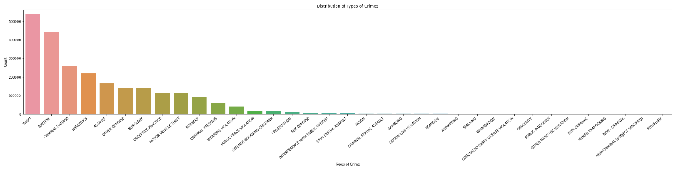
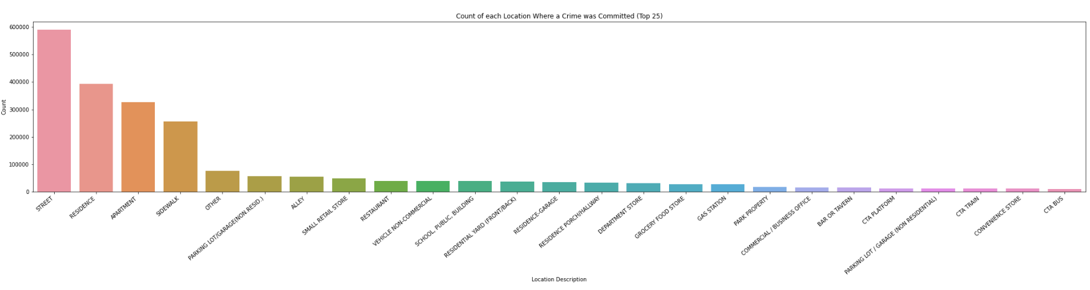
Major Crimes and their Locations in Chicago.

Slide 5
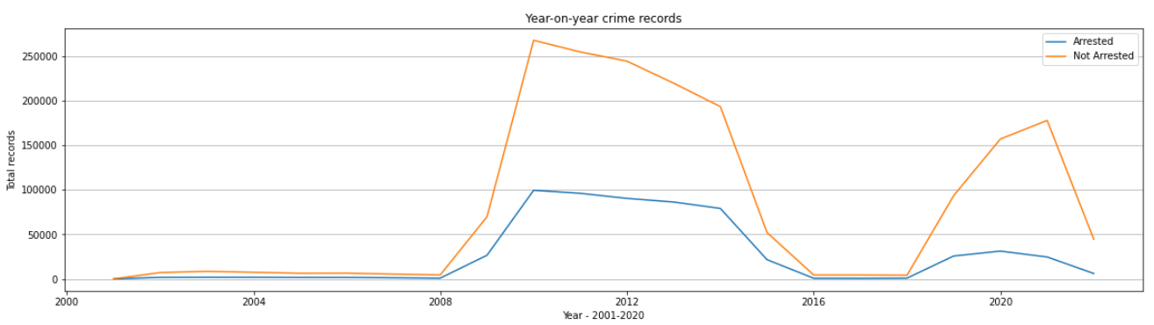
How many Arrests have happened over the past 20 years.
The dataset of past 20 years shows that there is a huge increase in the number of crimes after the year 2008
We can also observe the crime rate has fallen down after the 2016 to 2018

Slide 6
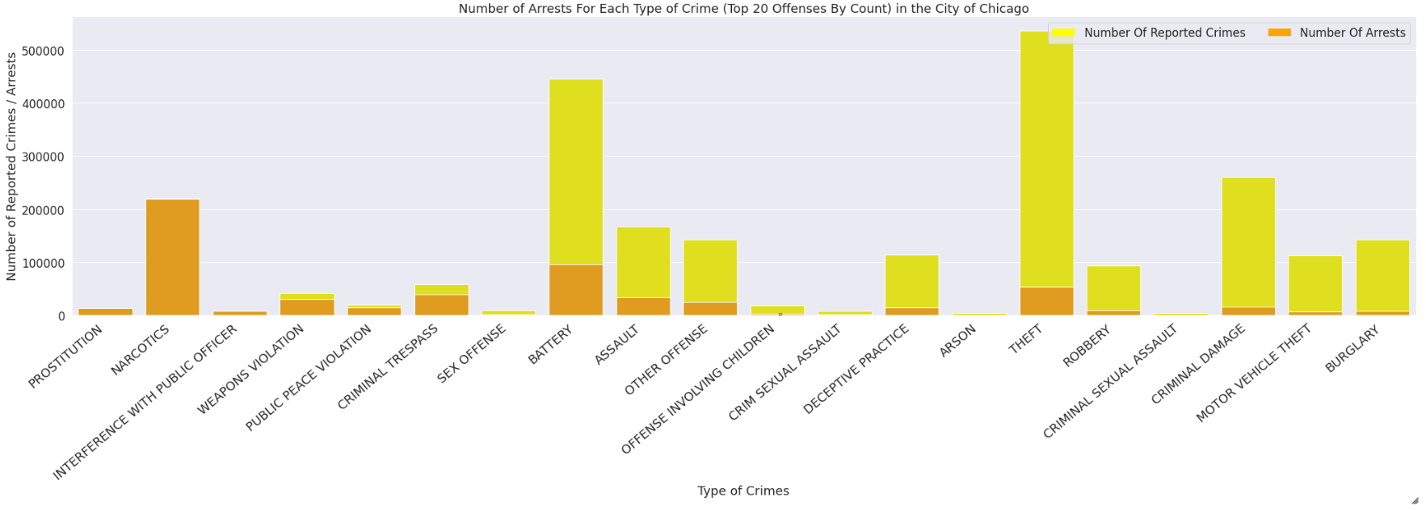
Stacked barplot for Crimes in Chicago.
As we can see from the stacked bar-plot above there is correlation between a reported crime and an arrest for that crime for certain infraction types.
If a narcotics offense is reported there is almost a 100% chance that an arrest will be made.
Criminal trespassing, interference with a public officer, gambling, and liquor law violations also have high arrest rates.

Slide 7
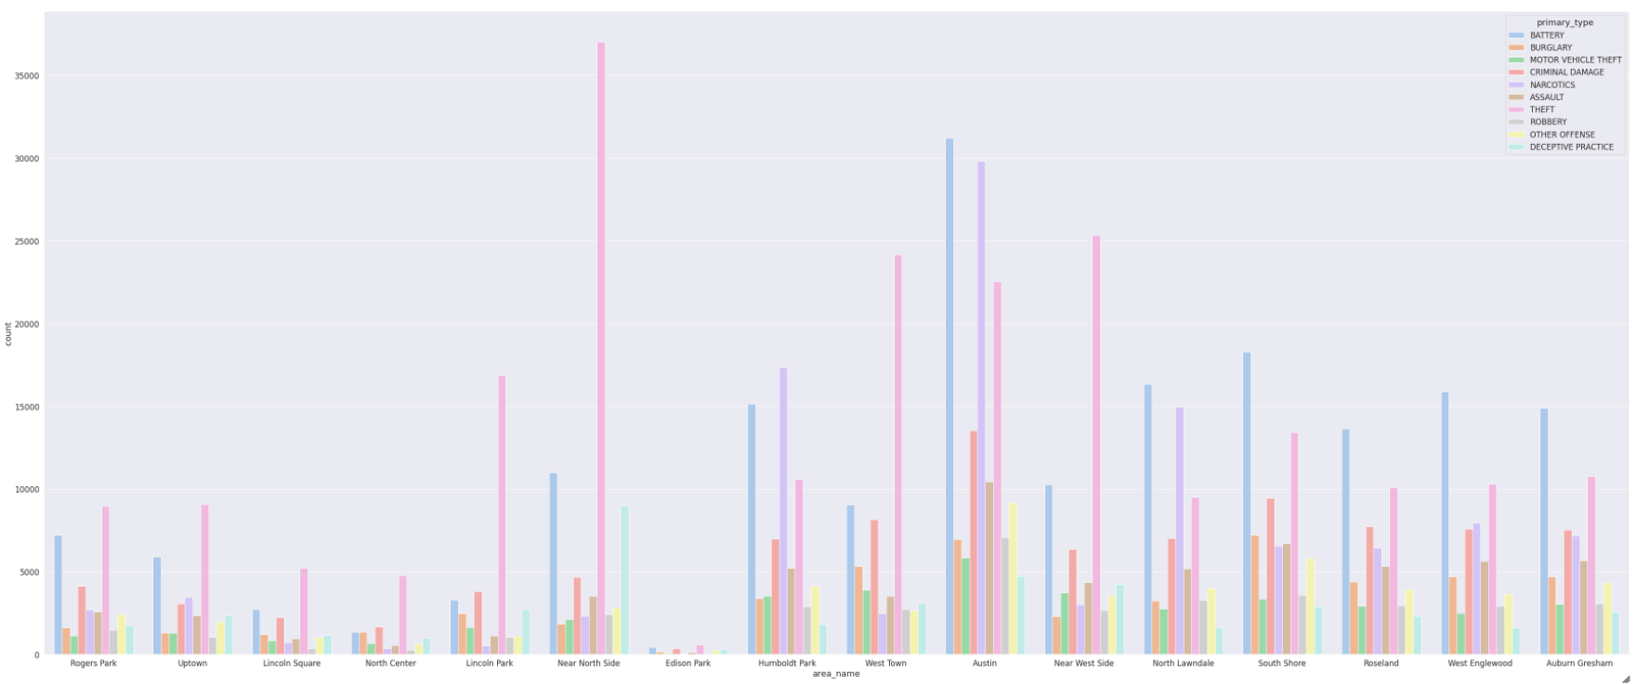
Top 10 areas with Top-rated Crimes.
Northern region and Western region with a few locations from the southern region have the most reported crimes. Hence, we can say that the Eastern area is more safer than any of the these and might be more expensive.
Austin seems to have the most number of Crimes like Battery, Theft and Narcotics.
We can see that areas like Near North side, West Town and Austin tend to show very high crime rates.

Slide 8
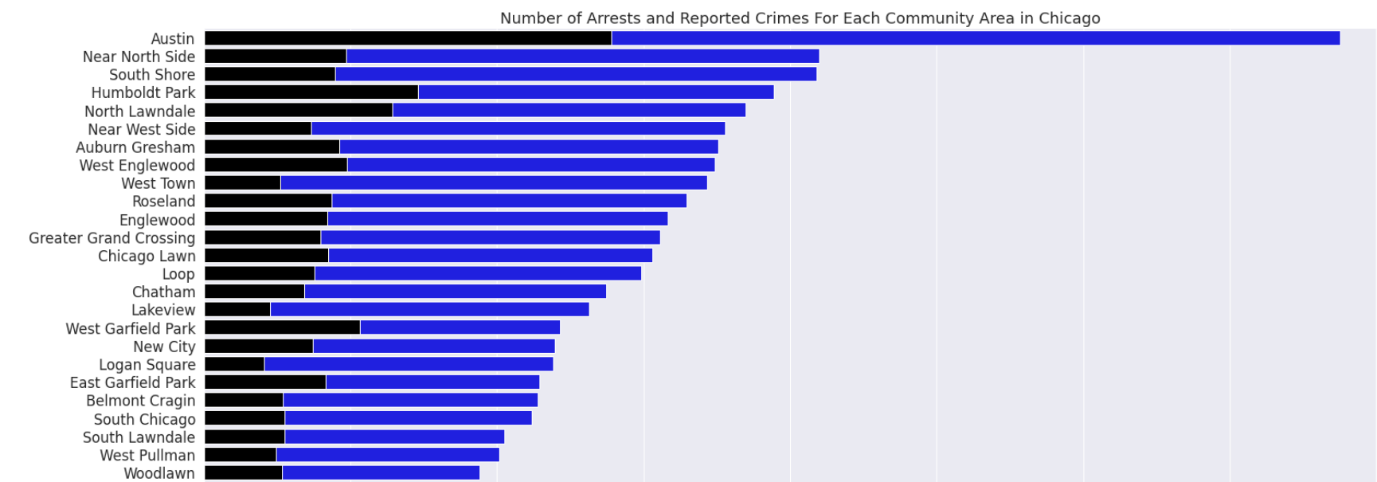
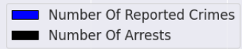
Top 25 Arrests and Reported Crimes for Community area in Chicago.
-As shown in the graph above, the number of arrests rises in tandem with the number of crimes committed in a certain location.
-If we base that assertion just on counts, we can also conclude that regions of Chicago like Austin and the Near North Side are considerably more likely to see both a crime and an arrest than Edison Park or Burnside.

Slide 9
Comparing Chicago Crime Data
And
Zillow Rental Data

Slide 10
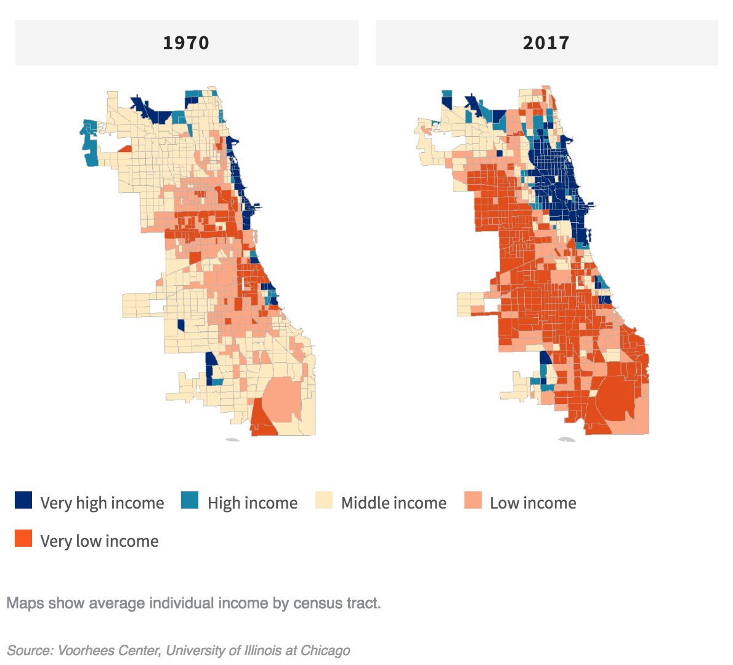
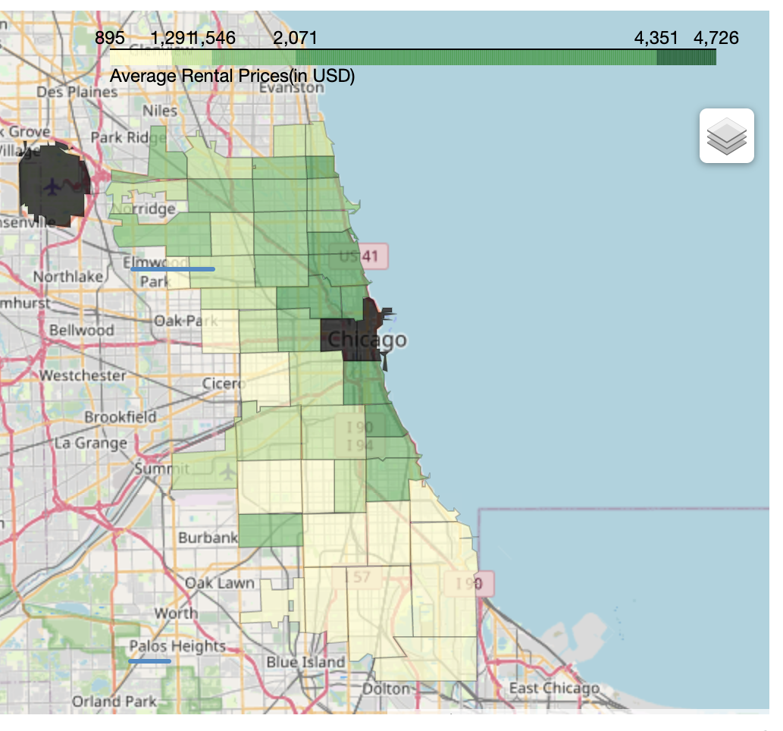
Average Rental Prices:
Average income level for Chicago
Average rental prices for Chicago

Slide 11
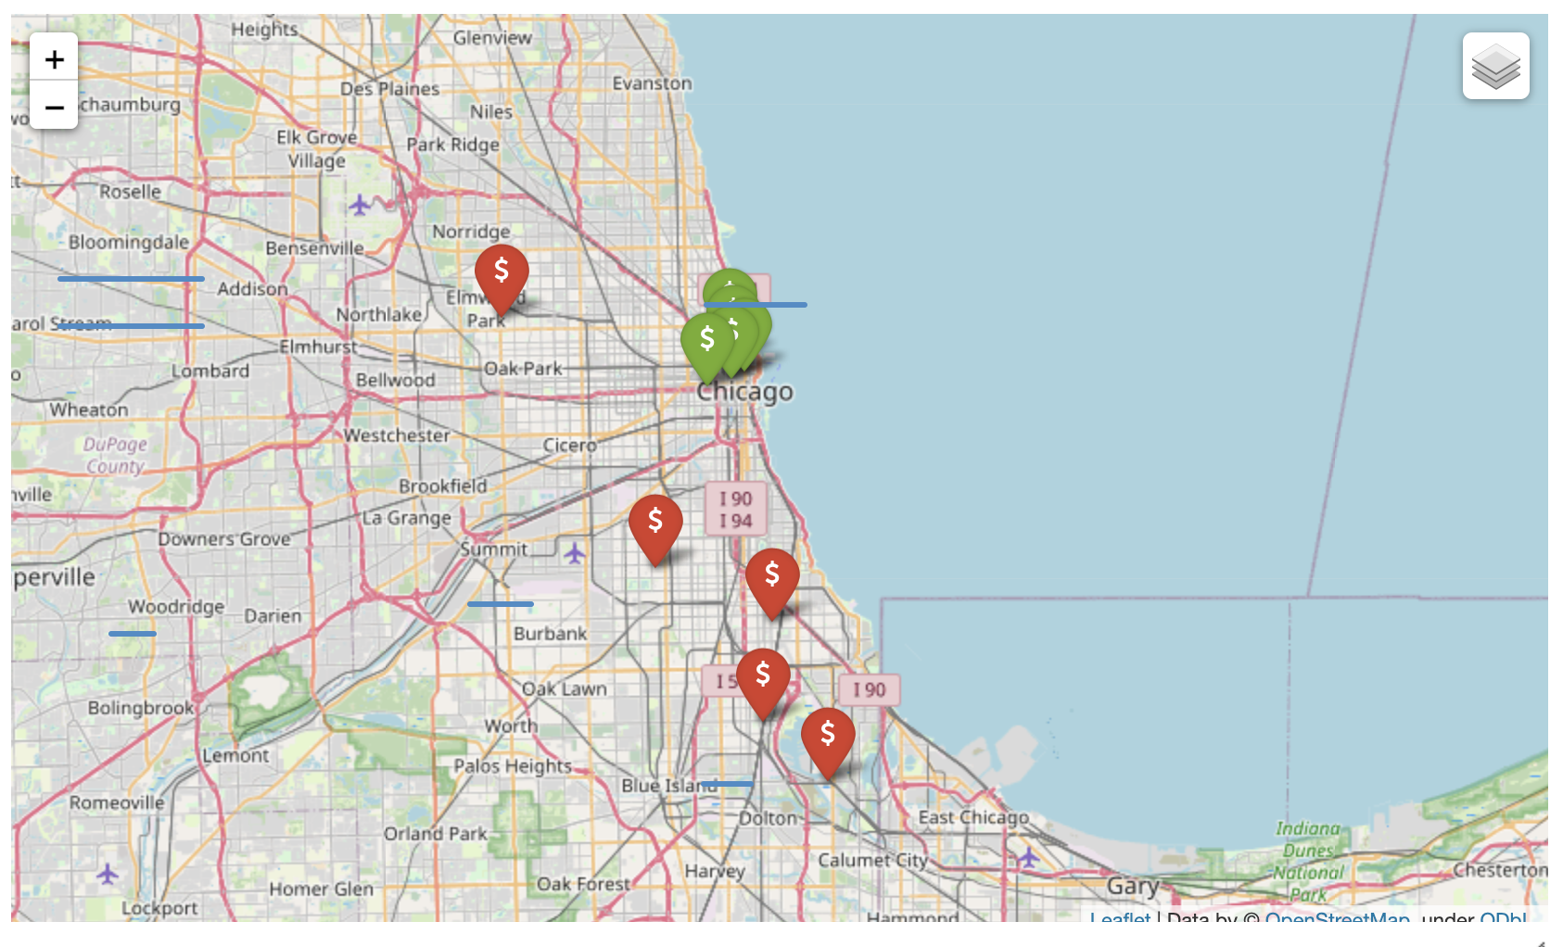
5 most expensive areas vs 5 least expensive areas
- The green location pins represent the 5 most expensive rental areas
- The red location pins represent the 5 least expensive rental areas
- It follows our earlier observation that areas near the north of the city and near the shoreline are expensive and the rental rate decreases as we move inwards within the city

Slide 12
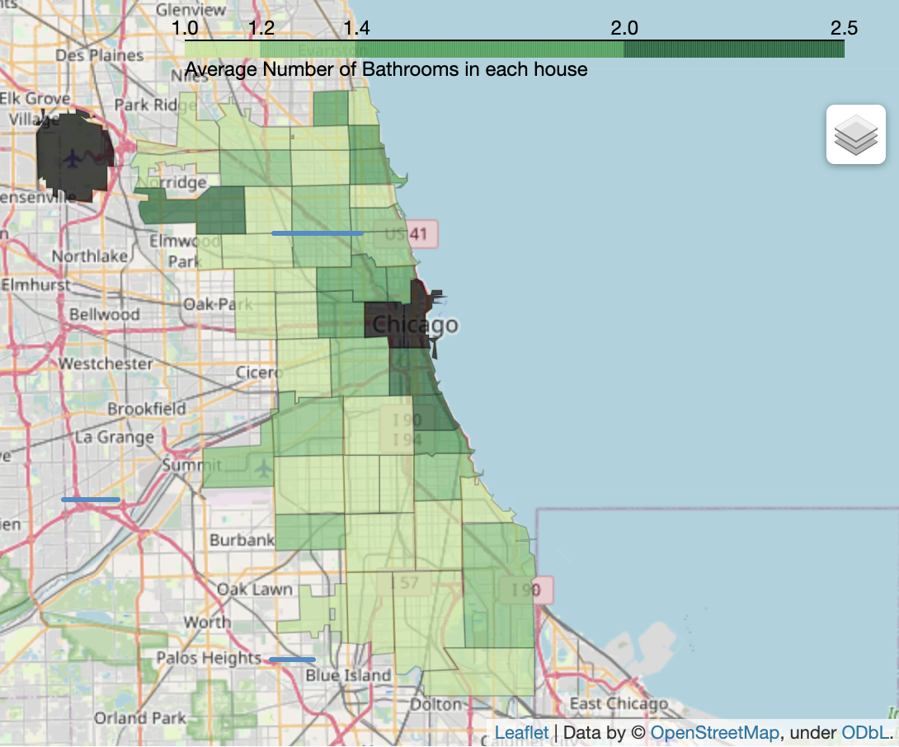
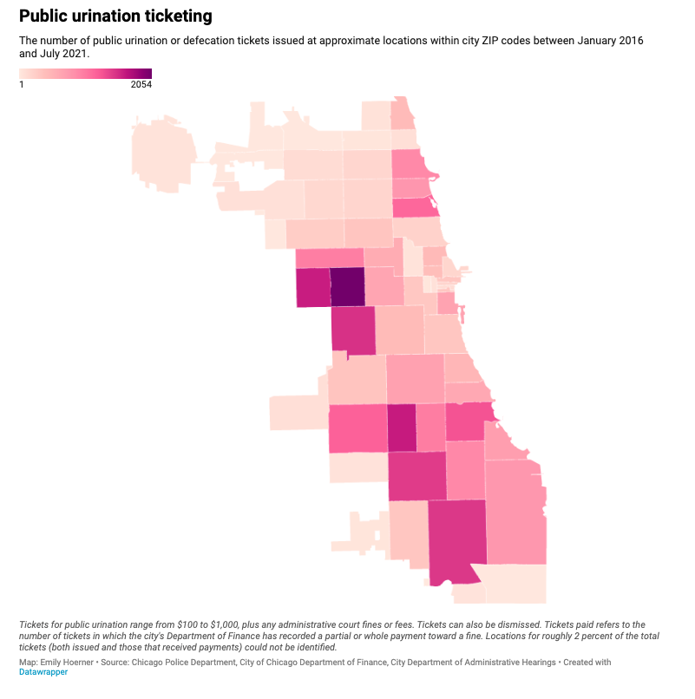
Average number of bathrooms
- The green map from our notebook shows the average number of bathrooms per house
- We can observe that houses that fall in the low income areas in the previous map have lower number of bathrooms
- The pink map represents the public urination tickets issues in Chicago between 2016 and 2021
- We can see that people in areas with lower number of bathrooms in houses have been issued more tickets
- We can observe that people living in low level incomes have limited access to restrooms to expel waste, one which is considered to be a basic human right by the United Nation

Slide 13
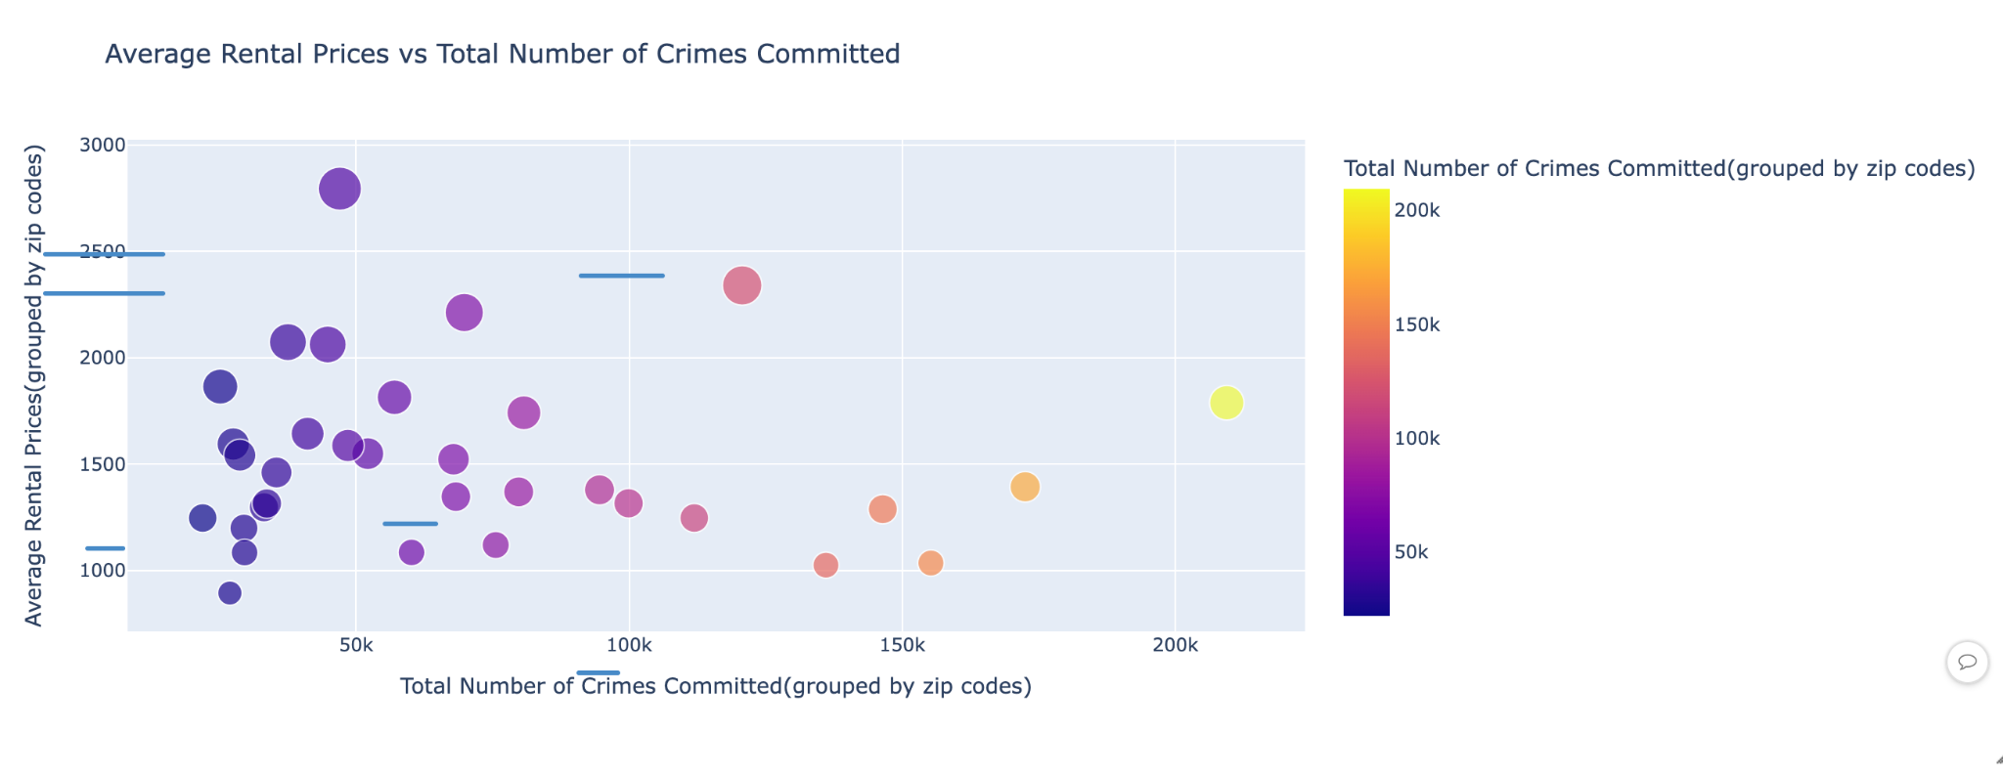
Average rental prices vs Total number of crimes
- The graph represents Average rental prices vs Total number of crimes reported
- Areas with a low total crime rate naturally have a higher rental price
- Some areas with higher crime rate still have a higher rental rate, this is dues to the fact that this graph includes petty crimes as well
- Analyzing only homicides will give us a clear picture in terms of how crime affects rental prices

Slide 14
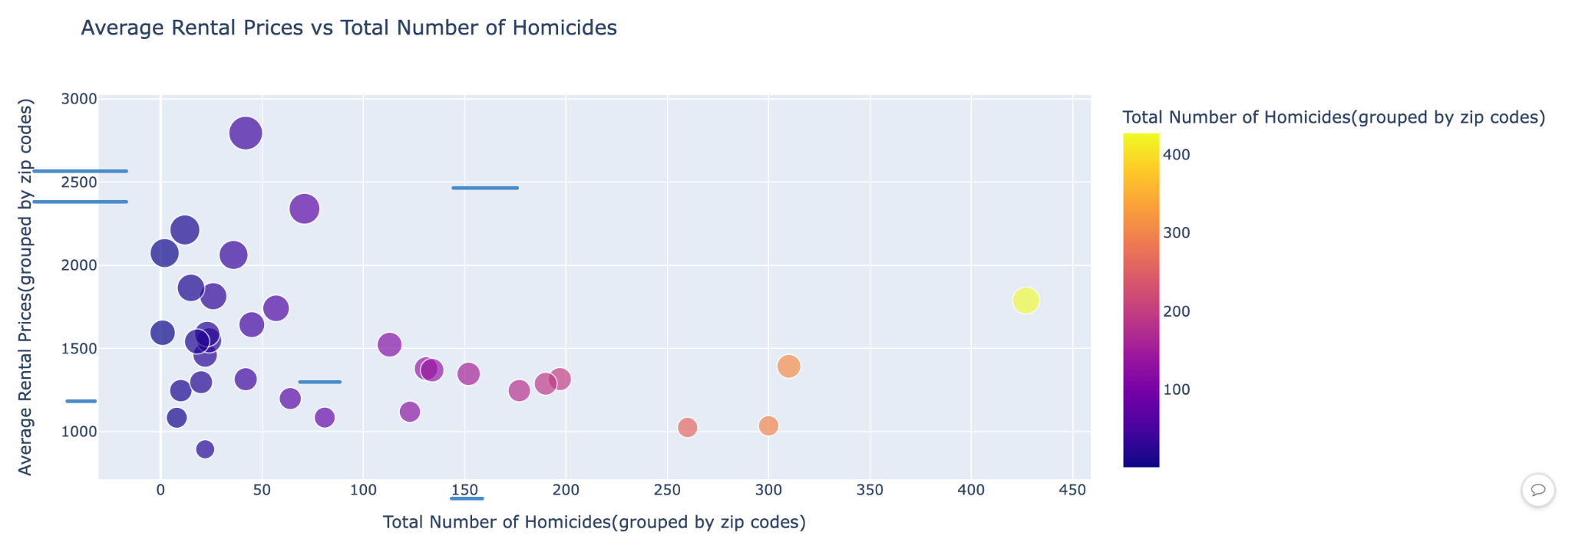
Average rental prices vs Total number of homicides reported
- The graph represents Average rental prices vs Total number of homicides per zip code
- This graph gives us a better comparison between Homicides and Average Rental Prices. We can see that areas, where comparatively lower number of homicides were reported had a higher average rental rate
- This graph shows that brutal crimes have a greater impact on rental prices than non-brutal crimes

Slide 15
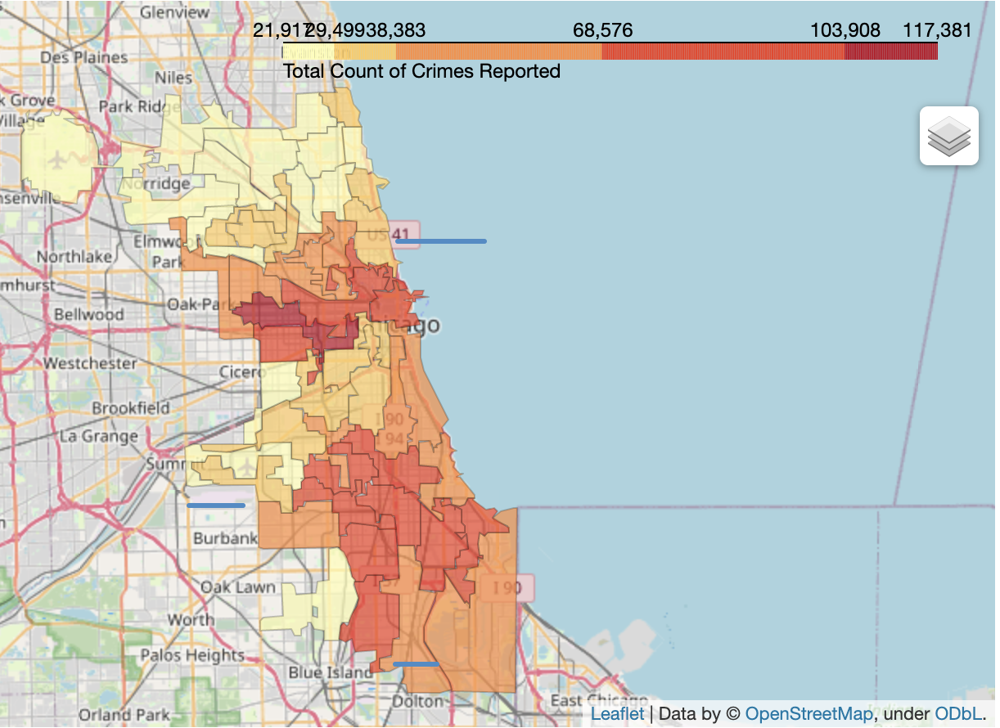
Plotting the total count of crimes on the map
- Comparing total crimes reported vs Average rental prices
- Areas with higher crime rate have a lower average rental price, some areas are an exception,
- For most areas we can observe that higher the number of crimes, lower is the rental rate. To get a clearer picture we will have a look at homicides vs rental prices

Slide 16
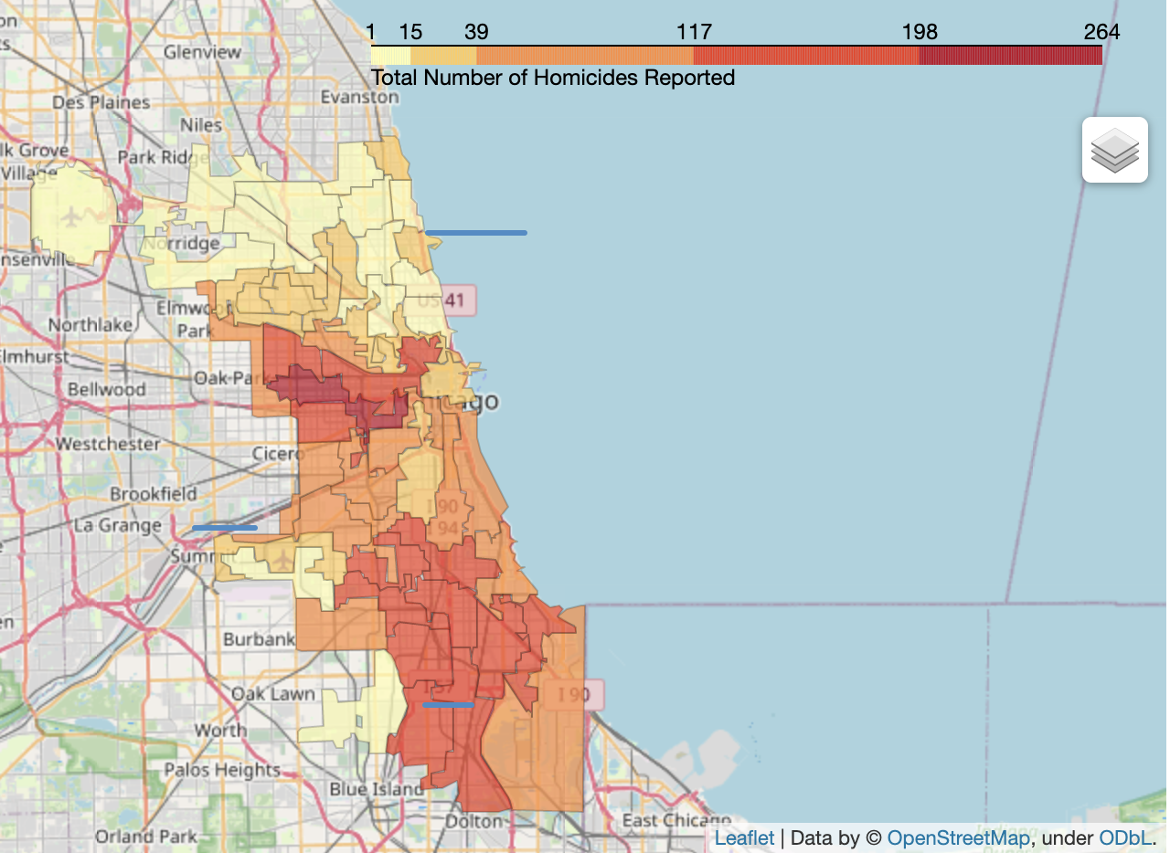
Plotting the total count of homicides on the map
- We can see that areas towards the western boundary of the city have lower rental prices and higher rate of homicides
- There is a subtle change, but we can observe that the darker portion moves from the northern shoreline area to the left towards the western boundary of Chicago city in case of total homicides reported from total crimes reported as seen in the previous comparison
- This further consolidates our point that brutal crimes have a higher impact on rental prices and areas with high crime rate have a lower rental rate

Slide 17
References:
https://data.cityofchicago.org/Public-Safety/Crimes-2001-to-Present/ijzp-q8t2
https://www.chicagotribune.com/investigations/ct-chicago-bathroom-access-lacking-20211021-rftay5sxgjbkrggvwfvlgvzmvm-htmlstory.html
Exploring Increasing Income Inequality in the United States: A Public Choice Approach - Scientific Figure on ResearchGate. Available from: https://www.researchgate.net/figure/Average-income-in-Chicago-neighborhoods-1970-and-2017-Source-Lutton-26_fig2_332584749 [accessed 10 May, 2022]

Slide 18
Thank you!

